Slide 1

INT247 Machine Learning Foundations
Lecture #2.1
K-Nearest Neighbour and Bayesian Learning

Slide 2
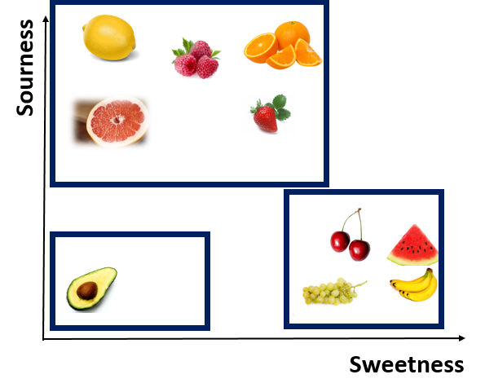
K- Nearest Neighbour Algorithm
Lazy Learner
Uses K “closest” points for performing classification.

Slide 3
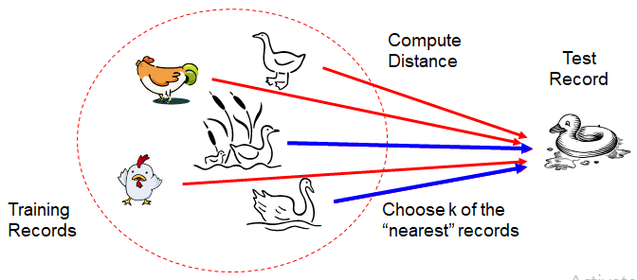
K- Nearest Neighbour Algorithm
If it walks like a duck, quacks like a duck, then it’s probably a duck

Slide 4
K- Nearest Neighbour Algorithm
Requires three things:
The set of stored records.
Distance Metric to compute distance between records.
The value of K, the number of nearest neighbours to retrieve .
To classify an unknown record:
Compute distance to other training records.
Identify k nearest neighbours.
Use class labels of nearest neighbours to determine the class label of unknown record.

Slide 5
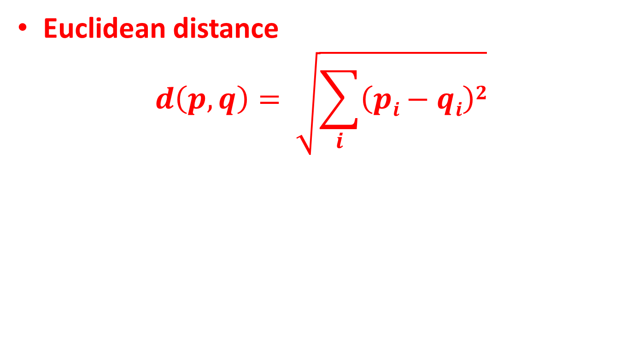
Compute Distance
Euclidean distance
$$d\left(p,q\right)= \sqrt{\sum_{i}{\left(pi−qi\right)2}}$$

Slide 6
Numerical Example
Consider a dataset with 2 attributes:
Acid durability (x1)
Strength (x2)
to classify whether a special paper tissue is good or bad (y).
x1 x2 y
7 7 Bad
7 4 Bad
3 4 Good
1 4 Good
Classify paper tissue with x1=3 and x2=7 considering K=3.

Slide 7
K- Nearest Neighbour Algorithm
Note:
If K is too small, sensitive to noise points.
If K is too large, neighbourhood may include points from other classes.

Slide 8
Scaling Issues
Attributes may have to be scaled to prevent distance measures from being dominated by one of the attributes.
Examples:
Height of a person may vary from 1.5m to 1.8m
weight of a person may vary from 90lb to 300lb
income of a person may vary from $10K to $1M

Slide 9
Advantages of KNN
No assumption about data.
Simple algorithm.
High accuracy.
Versatile – useful for classification or regression.

Slide 10
Disadvantages of KNN
Computationally expensive.
High memory requirement.
Store all the training data.
Sensitive to irrelevant features and the scale of the data.

Slide 11
Bayesian Learning
Probabilistic approach to inference.
Quantities of interest are governed by probability distributions.
Optimal decisions can be made by reasoning about these probabilities together with observed training data.

Slide 12
Bayesian Learning
Initial knowledge of many probabilities is required.
Significant computational costs required.

Slide 13
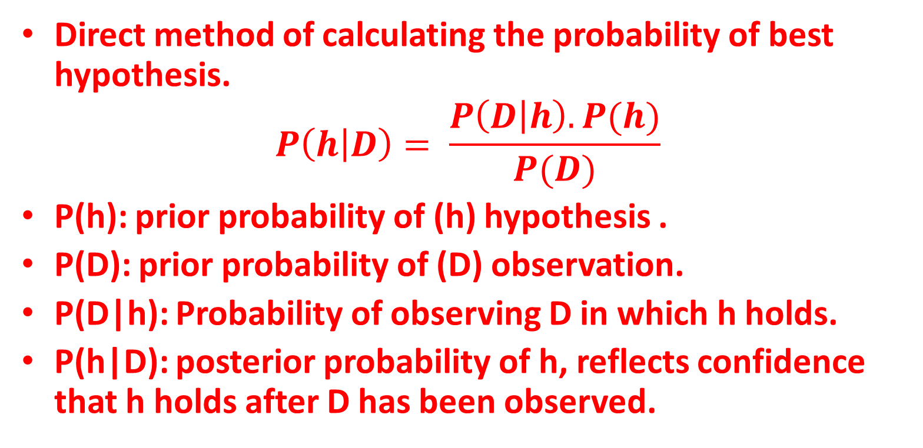
Bayes Theorem
Direct method of calculating the probability of best hypothesis.
$$P\left(h | D\right)= \frac{P\left(D | h\right).P(h)}{P(D)}$$
P(h): prior probability of (h) hypothesis .
P(D): prior probability of (D) observation.
P(D|h): Probability of observing D in which h holds.
P(h|D): posterior probability of h, reflects confidence that h holds after D has been observed.

Slide 14
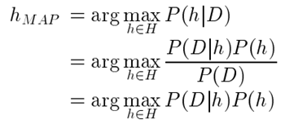
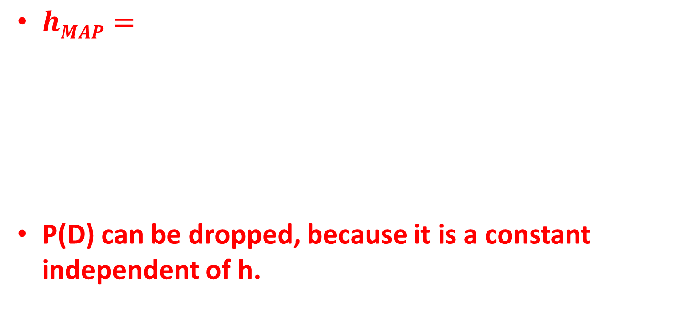
MAP (Maximum a Posteriori) Hypothesis
$hMAP=$
P(D) can be dropped, because it is a constant independent of h.

Slide 15
Example
Consider a medical diagnosis problem where:
P(cancer)=0.008
P(pos|cancer)=0.98
P(pos|~cancer)=0.03
If a new patient comes in with a positive test result, what is the probability that he has cancer?
P(pos|cancer).P(cancer)=0.98*0.008=0.0078
P(pos|~cancer).P(~cancer)=0.03*0.992=0.0298
Thus, h_{MAP} = ~cancer

Slide 16
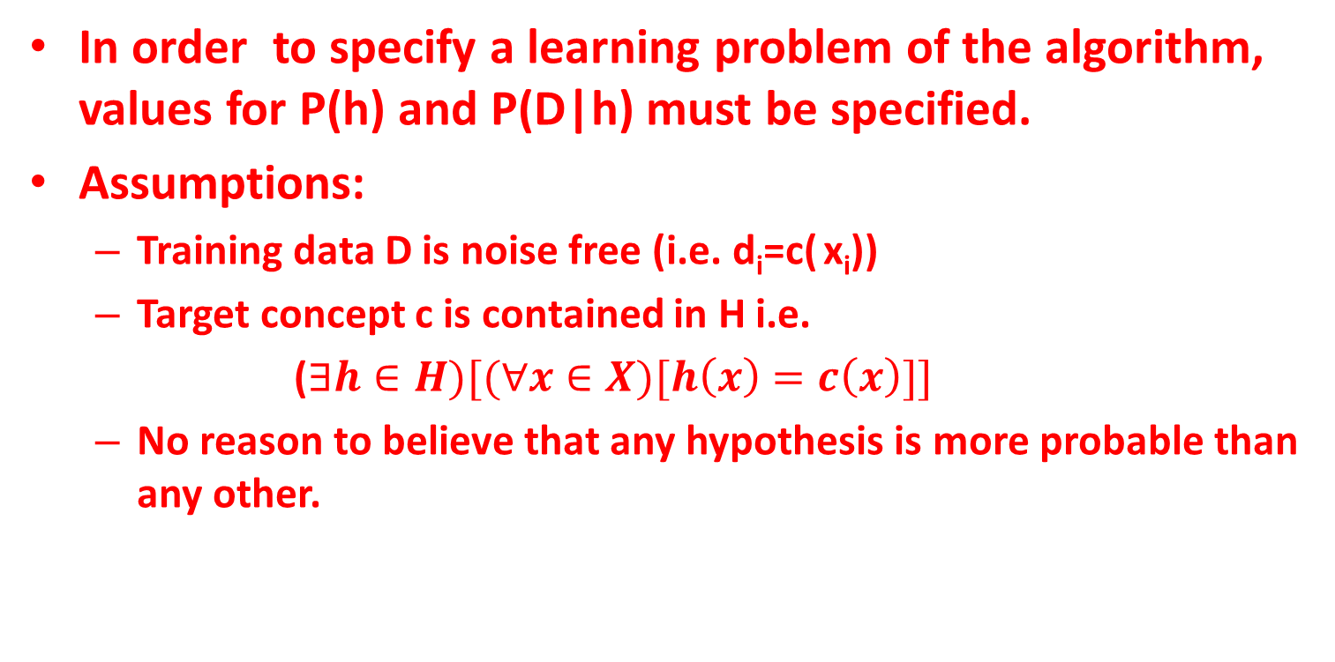
Brute Force MAP Learning
In order to specify a learning problem of the algorithm, values for P(h) and P(D|h) must be specified.
Assumptions:
Training data D is noise free (i.e. d_{i}=c( x_{i}))
Target concept c is contained in H i.e.
($∃h∈H)[(∀x∈X)[h\left(x\right)=c\left(x\right)]]$
No reason to believe that any hypothesis is more probable than any other.

Slide 17
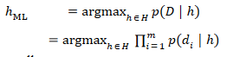
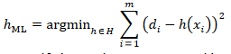
Learning a Real-Valued function
Consider any real-value target function f.
Training examples <x_{i},d_{i}>, where d_{i} is noisy training value.
d_{i}=f(x_{i})+e_{i}
Where e_{i} is random variable drawn independently for each x_{i} according to some Gaussian distribution with mean=0.
The maximum likelihood hypothesis h_{ML} is defined as:

Slide 18

Example of Naïve Bayes Classifier
Dataset with 3 classes:
Parrot
Dog
Fish
4 features:
Swim
Wings
Green Color
Dangerous Teeth

Slide 19
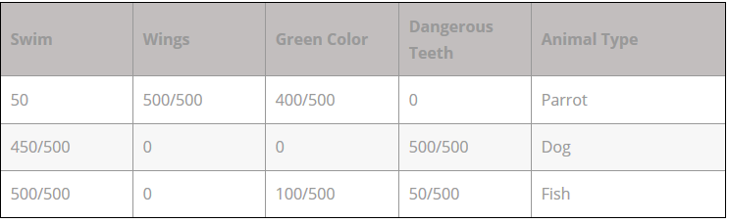
Example of Naïve Bayes Classifier
Table shows a frequency table of dataset.

Slide 20
Example of Naïve Bayes Classifier
Considering the dataset predict the type of animal if:
Swim=True
Wings=False
Green=True
Teeth=False

Slide 21
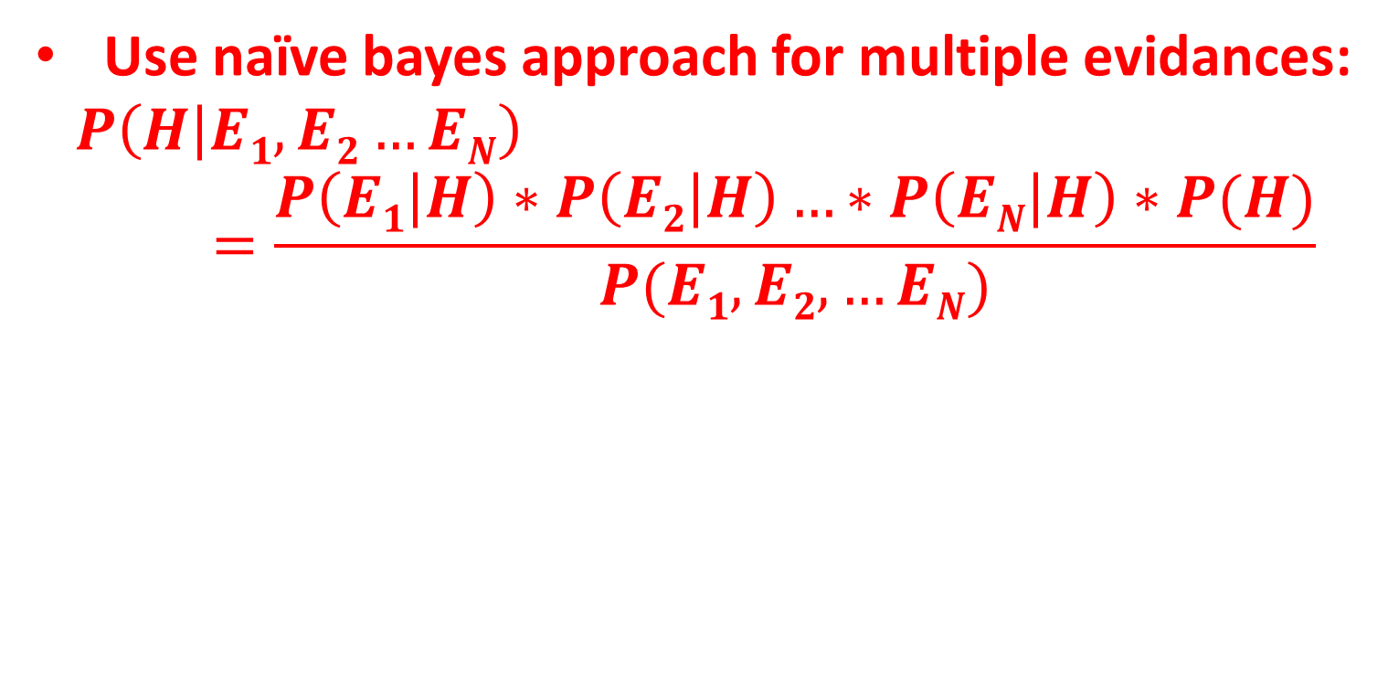
Example of Naïve Bayes Classifier
Use naïve bayes approach for multiple evidances:
$$P\left(H | E1,E2…EN\right)=\frac{P\left(E1 | H\right)∗P\left(E2 | H\right)…∗P\left(EN | H\right)∗P(H)}{P(E1, E2,…EN)}$$

Slide 22
Example of Naïve Bayes Classifier
For hypothesis testing for animal to be a dog:
P(Dog|Swim , Green)=P(Swim|Dog)*P(Green|Dog)*P(Dog)/P(Swim, Green)
=0.9*0*0.333/P(Swim, Green)
=0

Slide 23
Example of Naïve Bayes Classifier
For hypothesis testing for animal to be a Parrot:
P(Parrot|Swim , Green)=P(Swim|Parrot)*P(Green|Parrot)*P(Parrot)/P(Swim, Green)
=0.1*0.8*0.333/P(Swim, Green)
=0.0264/P(Swim, Green)

Slide 24
Example of Naïve Bayes Classifier
For hypothesis testing for animal to be a Fish:
P(Fish|Swim , Green)=P(Swim|Fish)*P(Green|Fish)*P(Fish)/P(Swim, Green)
=1*0.2*0.333/P(Swim, Green)
=0.0666/P(Swim, Green)

Slide 25
Example of Naïve Bayes Classifier
For all the three cases, denominator is same.
The value of P(Fish|Swim, Green) is greater than P(Parrot|Swim, Green).
Thus, Class of animal is Fish.

Slide 26
Exercise
Predict the class of animal if:
Swim=True
Wings=False
Green=True
Teeth=True

Slide 27


